Slide 1


INTERVENTION BY NGO AMARANTA
PRE-SESSION OF THE IV CYCLE OF THE UPR FOR CHILE
CURRENT SITUATION OF WOMEN'S RIGHTS AND SEXUAL AND REPRODUCTIVE RIGHTS IN CHILE
With emphasis on the Biobío Region
Geneva, Switzerland, 2024

Slide 2

INTERVENTION BY NGO AMARANTA
PRE-SESSION OF THE IV CYCLE OF THE UPR FOR CHILE
  Amaranta is a space for feminist work, research and education born in 2018 in Concepción, Chile, formed by a team of 11 women from the cities of Concepción, Chillán, Linares and Santiago (amarantas.org).
  Our country conducted national consultations. We attended the online version.
  This statement focuses on: Figures, reflections and findings gathered educating on sexuality in the Biobío Region (about 500 kilometers south of the capital of Santiago) and nationwide figures on gender-based violence facilitated by technology.
Geneva, Switzerland, 2024

Slide 3
INTERVENTION BY NGO AMARANTA
PRE-SESSION OF THE IV CYCLE OF THE UPR FOR CHILE
Chile accepted in the III UPR cycle recommendations to:
  Address gender stereotypes (38 and from 157 to 161)
  Implement comprehensive sexual education in schools (125, 138)
  As well as guarantee a life free of violence for women and girls, including in the digital space (from 162 to 178).
Although progress has been made, there are still shortcomings and pending challenges, which are worse outside the capital cities (peripheries, rural territories, interior provinces), according to our field work.
Geneva, Switzerland, 2024

Slide 4
INTERVENTION BY NGO AMARANTA
PRE-SESSION OF THE IV CYCLE OF THE UPR FOR CHILE
  Main source of information: Lilén Program, cycle of educational workshops with a gender and human rights perspective. This project has benefited:
7
900
90
high schools
students
teachers
And we continue to add

Slide 5
OUR FINDINGS ON GENDER STEREOTYPES
In students:
  Less participation (and even disinterest) of male students in topics related to gender violence.
  Unequal sex-affective relationships based on stereotypes.
  Conservative family nuclei in which unpaid work continues to fall on women.
In teachers:
  Lack of knowledge of the gender perspective and how to bring it into their work and the classroom.
  Reluctance to recognize sexual diversities
  Teachers who recognized having unequal perceptions of their students based on their gender, making it difficult for women to access other areas of study.

Slide 6
OUR FINDINGS FROM SEX EDUCATION WORKSHOPS
In students:
  Numerous cases of street harassment against female students (who are not aware of the current Law against Street Harassment).
  Lack of knowledge about basic concepts of sexuality.
  No access to information on their sexual and reproductive rights.
  Overexposure to pornography.
  Lack of knowledge about the practical use of barrier methods, lubricants and contraceptive methods.
  Lack of knowledge of the current Three-Case Abortion Law.
  Shame to talk about topics such as menstruation.
  Poor information about HIV.
  Cases of adolescent pregnancy and abortion.

Slide 7
OUR FINDINGS ON GENDER-BASED VIOLENCE
2
24
recent femicides of students in two of the high schools we work at
courses or groups of student volunteers with whom we have worked had cases of violence.
All
The most reported forms of violence were: cyberbullying, street harassment, domestic violence, institutional violence, sexual violence (especially grooming and abuse) and relationship violence.

Slide 8
TECHNOLOGY-FACILITATED GENDER-BASED VIOLENCE
In 2020 we investigated the extent of gender-based violence on the Internet by surveying more than 500 women in all sixteen regions of the country.
73,8%
10,7%
12,2%
had suffered some form of violence in the digital space.
had not been initially identified as survivors, because the violence had occurred in an intimate context.
denunciated to the police or the Public Prosecutor's Office; and none of them obtained redress.

Slide 9
SUGGESTED RECOMMENDATIONS
  Incorporate training in gender perspective to the teaching career.
  Facilitate community training and discussion spaces on gender and human rights, decentralizing access to the subject.
  Promote as a matter of urgency the National Policy on Comprehensive Sex Affective Education, including spaces of Sex Ed for adults.
  Promote communication and educational strategies to publicize the Law against Street Harassment among the population
  Urgently enact the Law for the Right to a Life Free of Violence and the Law on Digital Violence.
  Generate and promote programs that educate about digital security and coexistence, with a gender and human rights perspective.

Slide 10
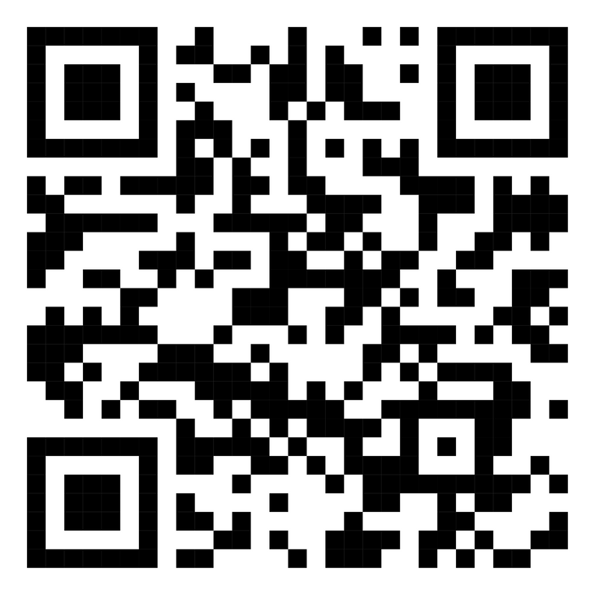
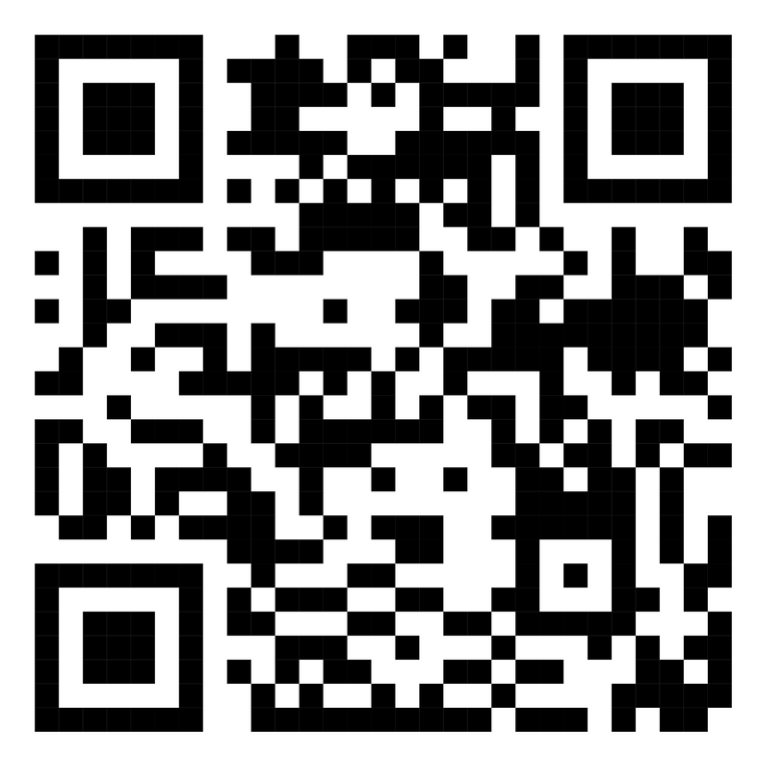
THANK YOU FOR YOUR ATTENTION
Cecilia Ananías from
READ THE FULL SHADOW REPORT HERE:
LEARN MORE ABOUT THE LILÉN PROGRAM HERE:

